Slide 1
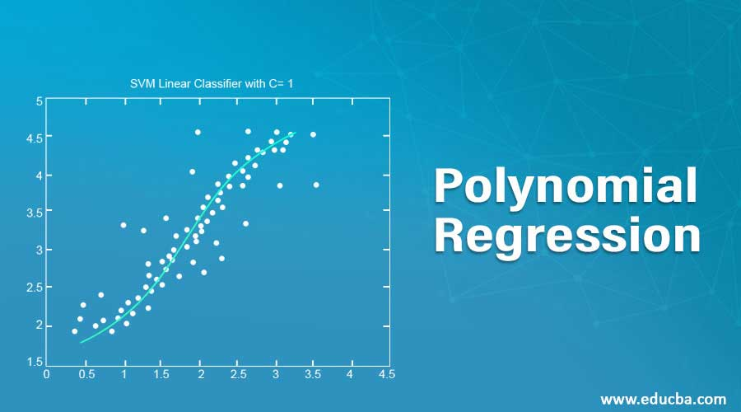

Slide 2
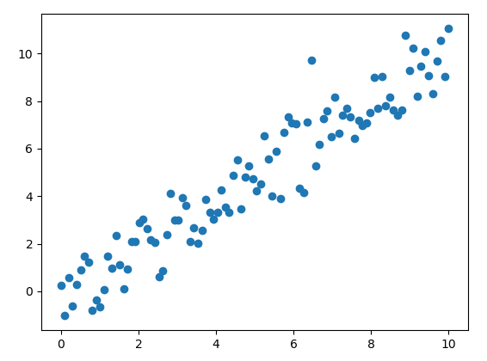

Slide 4
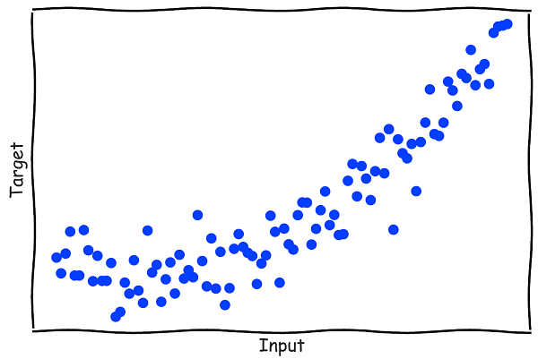
What about this ?

Slide 5
The best fit line is not enough !

Slide 6
We need to fit a curve ?

Slide 7
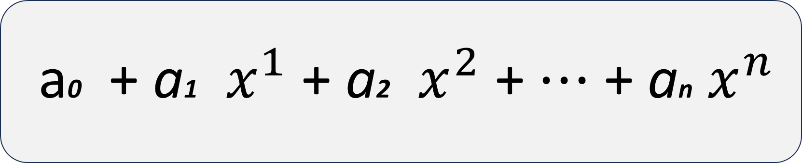
a0 + a1 ​​ $x^{1}$ + a2 ​ ​$x^{2}$ + $⋯$ + an ​$x^{n}$
Polynomials

Slide 8
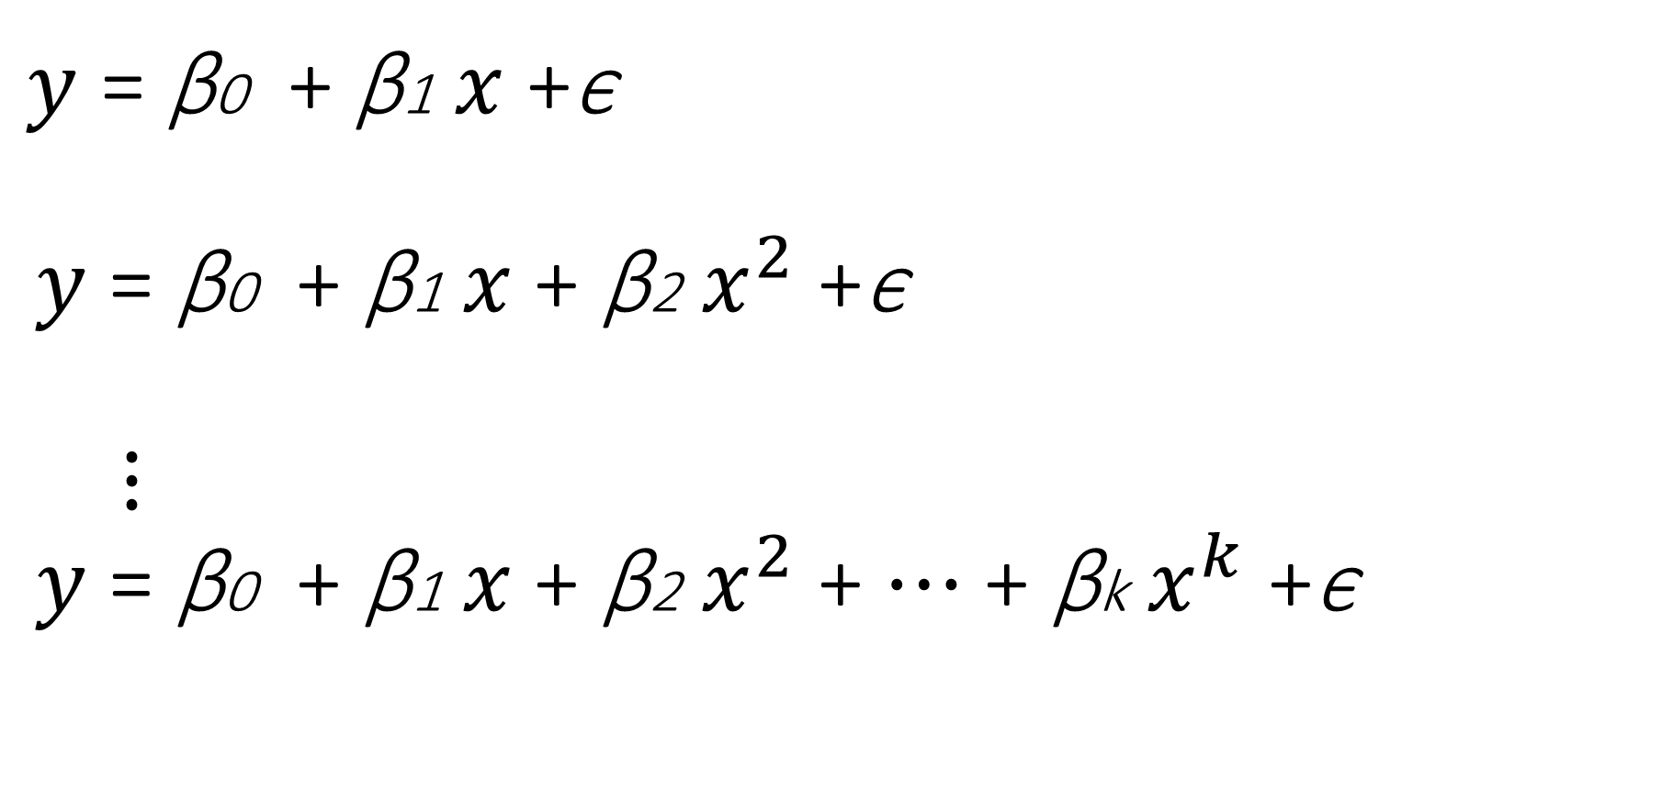
$y$ = β0 + β1 ​​$x$ +ϵ $y$ = β0 + β1 ​​$x$+ β2 $x^{2}$ +ϵ $⋮$ $y$ = β0 + β1 ​​$x$+ β2 $x^{2}$ + $⋯$ + βk $x^{k}$ +ϵ
Polynomial Regression

Slide 9
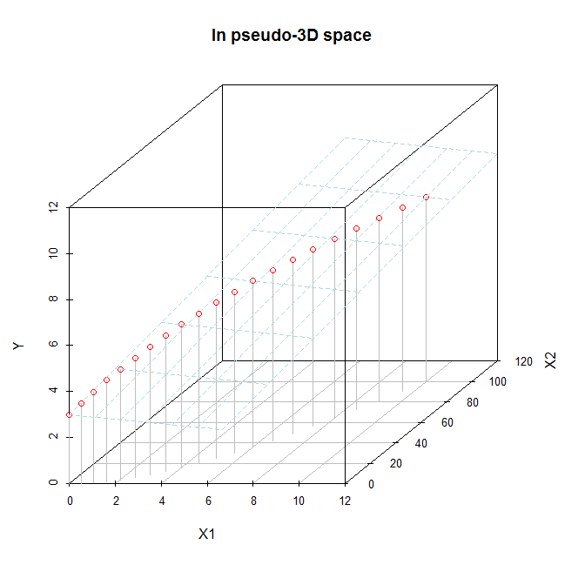

Slide 10
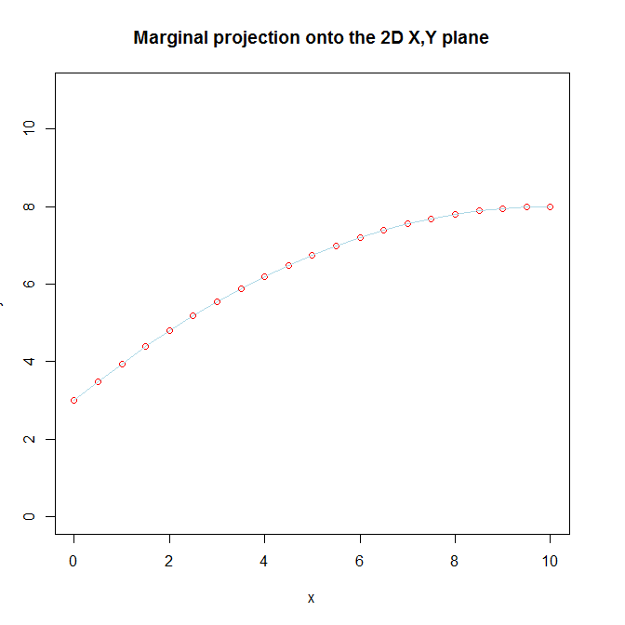

Slide 11


Slide 12
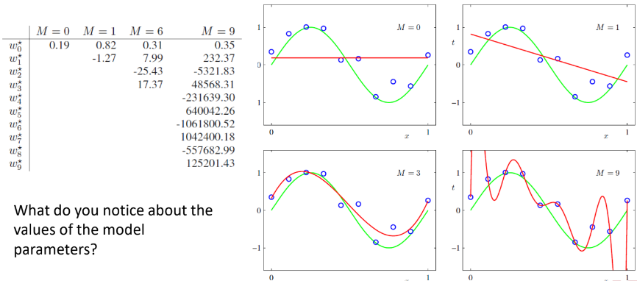

Slide 13
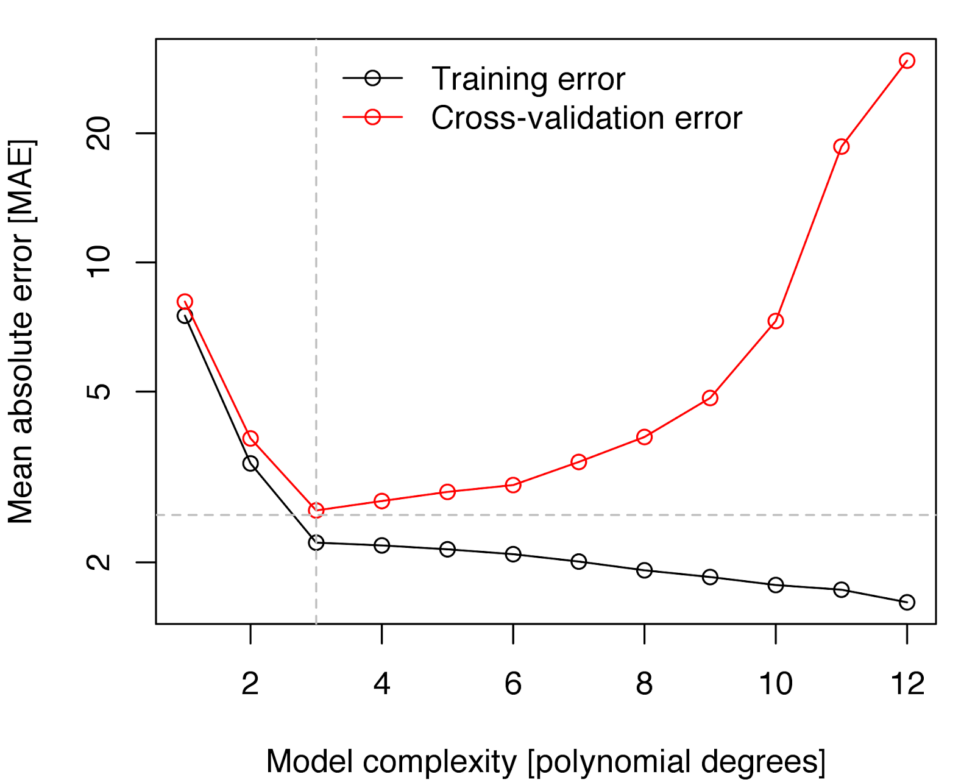

Testing error
Low variance
High bias
High variance
Low bias

Slide 14


Slide 15


Slide 16
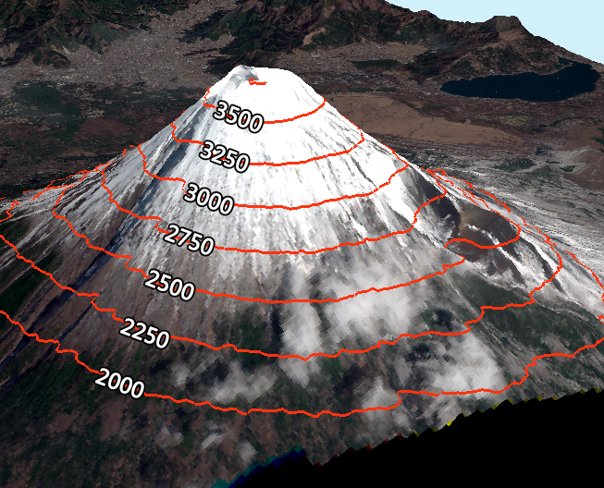
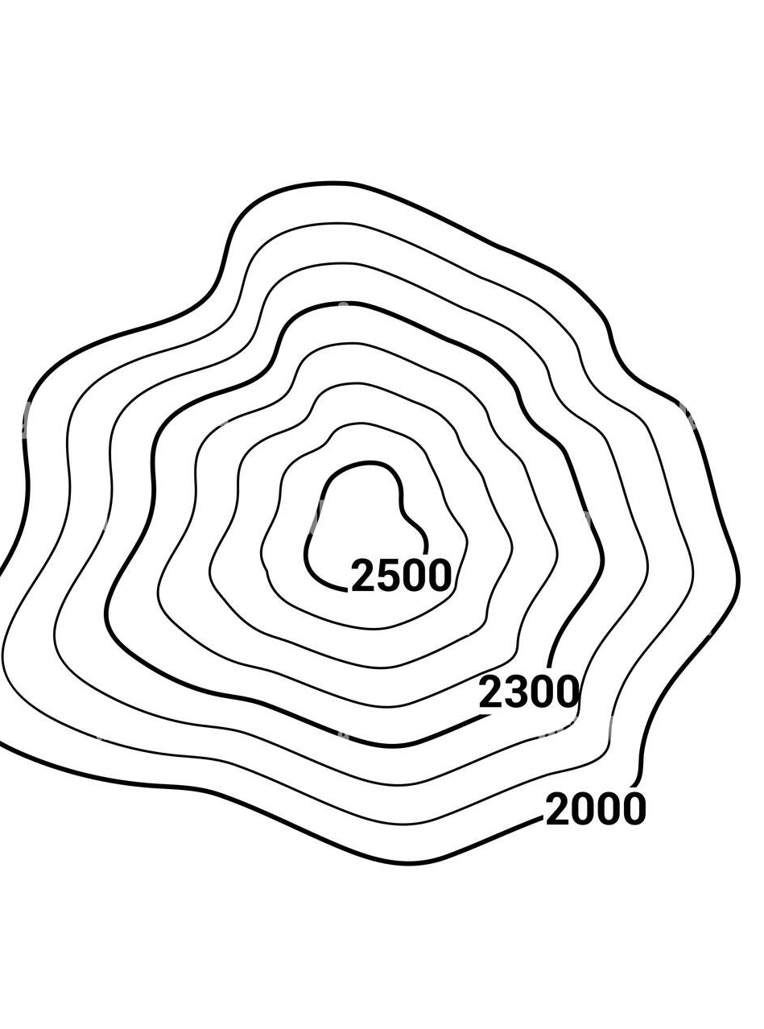

Slide 17
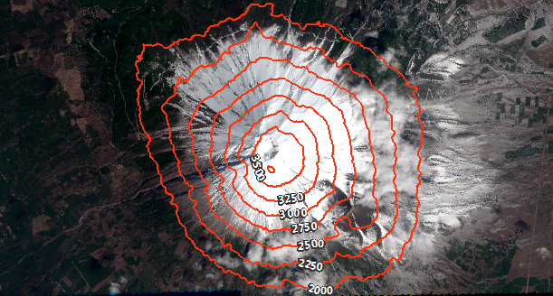

Slide 18
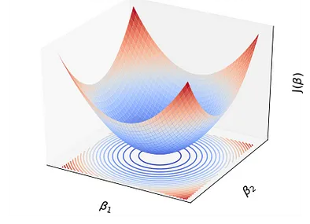
Contour plot for SSE function:

Slide 19
How can we prevent overfitting ?
- Best way is to train the model using more data, but sometimes this is difficult. - We can also reduce model complexity.
By using regularization techniques:
- Any modification we make to a learning algorithm that is intended to
reduce its generalization/test error, but not its training error.

Slide 20


Slide 21
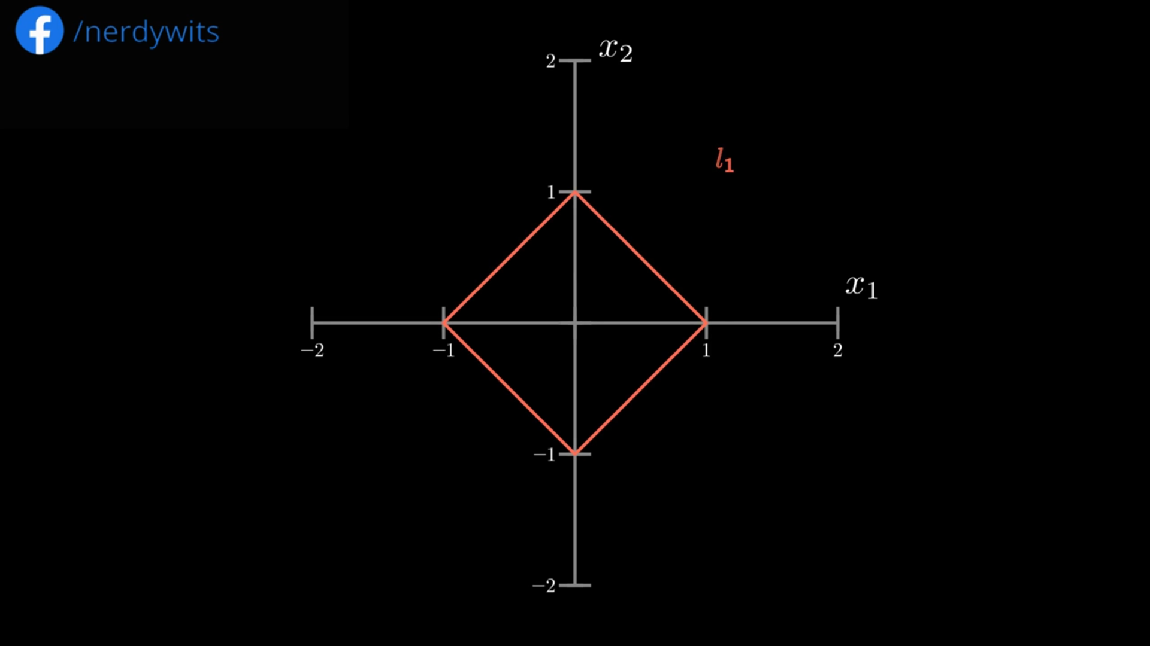
L¹ norm :

Slide 22
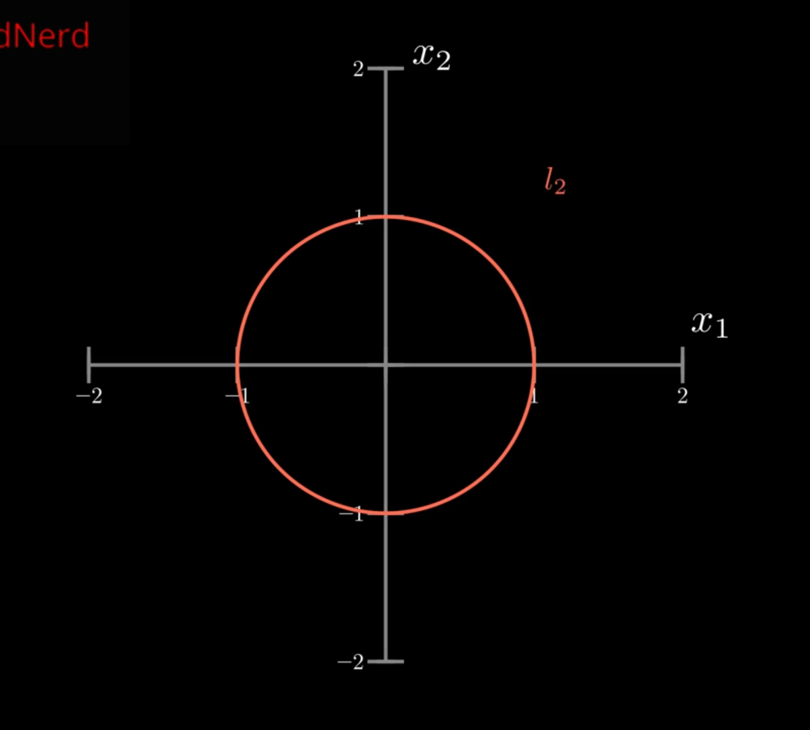

L² norm :

Slide 24
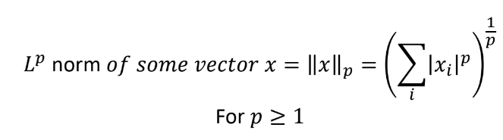
Regularization
- A possible way to avoid overfitting is to add extra terms in the objective function that can be thought as corresponding to a soft constraint on the parameter values.
- A measure the size of a vector (maps a vector to a non-negative value representing its size).
- L^{p} norm is given by :

Slide 25
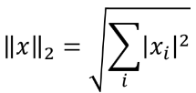
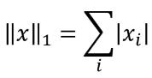
L¹ norm & L² norm
- For p=2 (L² norm ) :
- (L² norm is simply the Euclidean distance from the origin to the point identified by x)
- For p=1 (L¹ norm ) :

Slide 26
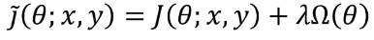
Using the norm to constrain parameter values
Basic idea: Adding a parameter norm penalty Ω(θ) to the objective function J :
- Where λ ∈ [0, ∞) is a hyper-parameter that weights the relative contribution of the norm penalty term Ω(θ)

Slide 27
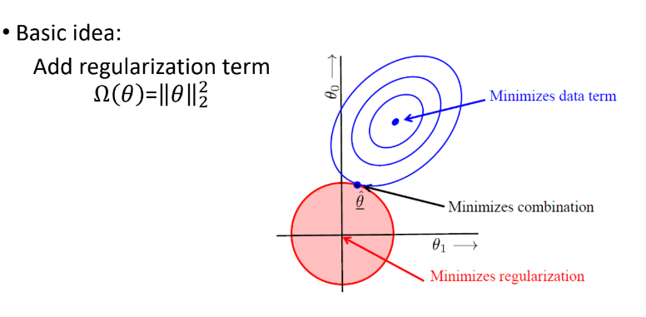
Ridge Regression

Slide 28
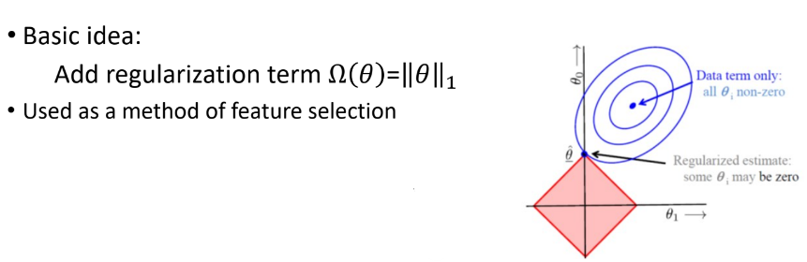
Lasso Regression

Slide 29
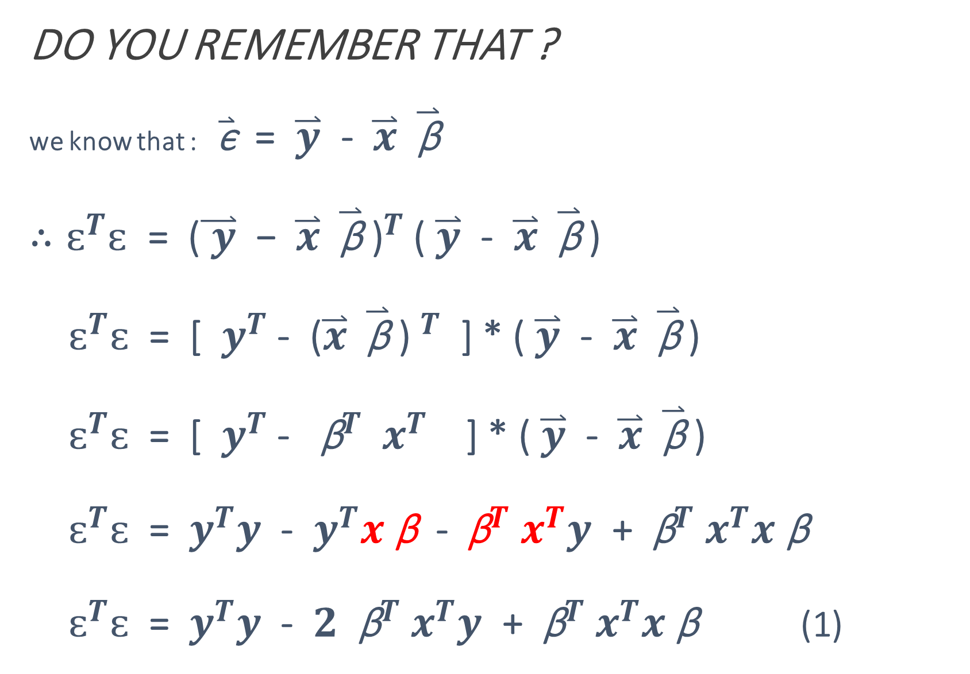
DO YOU REMEMBER THAT ? we know that : $\overset{⃑}{\text{ϵ}}$ = $\overset{⃑}{y}$ - $\overset{⃑}{x} \overset{⃑}{\text{β}}$ $∴ԑ^{T}ԑ$ = ${\text{(}\overset{⃑}{ y}\text{ − }\overset{⃑}{x} \overset{⃑}{\text{β}} \text{)}}^{T}$ ( $\overset{⃑}{y}$ - $\overset{⃑}{x} \overset{⃑}{\text{β}}$ ) $ԑ^{T}ԑ$ = [ $y^{T}$ - ${\text{(}\overset{⃑}{x} \overset{⃑}{\text{β}}\text{ ) }}^{T}$ ] * ( $\overset{⃑}{y}$ - $\overset{⃑}{x} \overset{⃑}{\text{β}}$ ) $ԑ^{T}ԑ$ = [ $y^{T}$ - ${ \text{β}}^{T}$ $x^{T}$ ] * ( $\overset{⃑}{y}$ - $\overset{⃑}{x} \overset{⃑}{\text{β}}$ ) $ԑ^{T}ԑ$ = $y^{T}y$ - $y^{T}x \text{β}$ - ${ \text{β}}^{T}$ $x^{T}y$ + ${ \text{β}}^{T}$ $x^{T}x \text{β}$ $ԑ^{T}ԑ$ = $y^{T}y$ - $2$ ${ \text{β}}^{T}$ $x^{T}y$ + ${ \text{β}}^{T}$ $x^{T}x \text{β}$ (1)

Slide 30
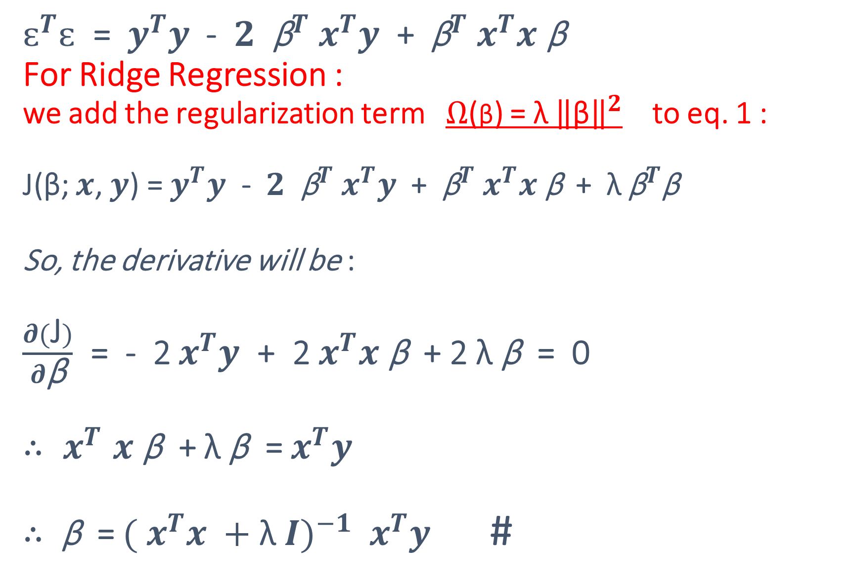
$ԑ^{T}ԑ$ = $y^{T}y$ - $2$ ${ \text{β}}^{T}$ $x^{T}y$ + ${ \text{β}}^{T}$ $x^{T}x \text{β}$ For Ridge Regression : we add the regularization term $Ω$(β) = λ ${\left\|\text{β}\right\|}^{2}$ to eq. 1 : J(β; $x$, $y$) = $y^{T}y$ - $2$ ${ \text{β}}^{T}$ $x^{T}y$ + ${ \text{β}}^{T}$ $x^{T}x \text{β}$ + λ ${\text{β}}^{T}$β So, the derivative will be : $\frac{∂(\text{J})}{∂\text{β}}$ = - 2 $x^{T}y$ + 2 $x^{T}x \text{β}$ + 2 λ β = 0 ${∴ x}^{T}x \text{β}$ + λ β = $x^{T}y$ $∴$ $\text{β}$ = ${({ x}^{T}x +\text{λ} I)}^{−1}$ $x^{T}y$ #
(1)

Slide 31



Slide 32
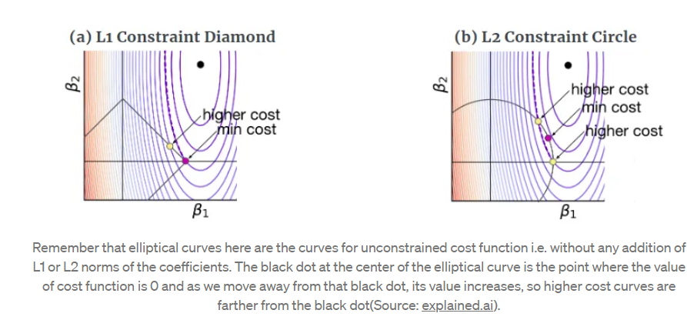

Slide 33
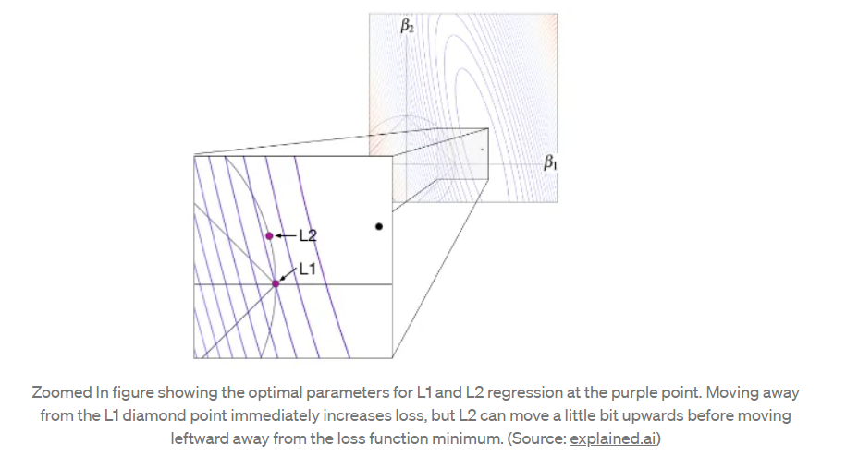

Slide 34
Conclusion
L¹ regularization, minimizes the sum of the absolute values
L² regularization minimizes the sum of squares.
Choosing L¹ or L² That depends on the specific problem
L¹ regularization has an important advantage: it tends to produce a sparse model. That is, it often sets many weights to zero, effectively declaring the corresponding attributes to be irrelevant.

Slide 35
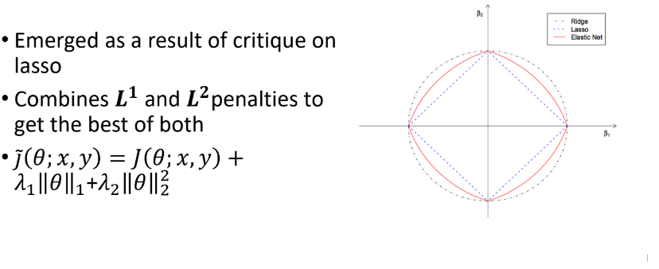
Elastic net

Slide 36
Thank you !

